Slide 1
Capital Budgeting
Capital Budgeting
“
“A long-term planning for making and financing proposed capital outlays”
“Capital Budgeting consists in planning and development of available capital for the purpose of maximizing the long-term profitability of an organization”

Slide 2
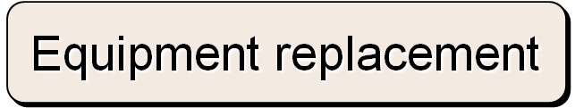
Typical Capital Budgeting Decisions
Plant expansion
Equipment selection
Lease or buy
Cost reduction
Notes:
Capital budgeting analysis can be used for any decision that involves an outlay now in order to obtain some future return. Typical capital budgeting decisions include:
Cost reduction decisions. Should new equipment be purchased to reduce costs?
Expansion decisions. Should a new plant or warehouse be purchased to increase capacity and sales?
Equipment selection decisions. Which of several available machines should be purchased?
Lease or buy decisions. Should new equipment be leased or purchased?
Equipment replacement decisions. Should old equipment be replaced now or later?

Slide 3
Typical Capital Budgeting Decisions
Capital budgeting tends to fall into two broad categories.
  Screening decisions. Does a proposed project meet some preset standard of acceptance?
  Preference decisions. Selecting from among several competing courses of action.
Notes:
There are two main types of capital budgeting decisions:
Screening decisions relate to whether a proposed project passes a preset hurdle. For example, a company may have a policy of accepting projects only if they promise a return of 20% on the investment.
Preference decisions relate to selecting among several competing courses of action. For example, a company may be considering several different machines to replace an existing machine on the assembly line.
In this chapter, we initially discuss ways of making screening decisions. Preference decisions are discussed toward the end of the chapter.

Slide 4

Time Value of Money
A rupee today is worth more than a rupee a year from now.
Therefore, projects that promise earlier returns are preferable to those that promise later returns.
Notes:
The time value of money concept recognizes that a dollar today is worth more than a dollar a year from now. Therefore, projects that promise earlier returns are preferable to those that promise later returns.

Slide 5

Time Value of Money
The capital budgeting techniques that best recognize the time value of money are those that involve discounted cash flows.
Notes:
The capital budgeting techniques that best recognize the time value of money are those that involve discounted cash flows (the concepts of discounting cash flows and using present value tables are explained in greater detail in Appendix 14A).

Slide 6
The Net Present Value Method
To determine net present value we . . .
  Calculate the present value of cash inflows,
  Calculate the present value of cash outflows,
  Subtract the present value of the outflows from the present value of the inflows.
Notes:
The net present value method compares the present value of a project’s cash inflows with the present value of its cash outflows. The difference between these two streams of cash flows is called the net present value.

Slide 7
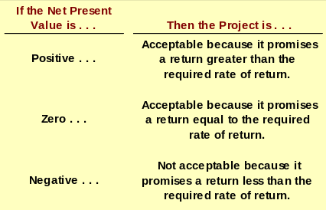
The Net Present Value Method
Notes:
The net present value is interpreted as follows:
If the net present value is positive, then the project is acceptable.
If the net present value is zero, then the project is acceptable.
If the net present value is negative, then the project is not acceptable.

Slide 8

The Net Present Value Method
Net present value analysis emphasizes cash flows and not accounting net income.
The reason is that accounting net income is based on accruals that ignore the timing of cash flows into and out of an organization.
Notes:
Net present value analysis (as well as the internal rate of return, which will be discussed shortly) emphasizes cash flows and not accounting net income. The reason is that accounting net income is based on accruals that ignore the timing of cash flows into and out of an organization.

Slide 9
Typical Cash Outflows
Repairs and
maintenance
Working
capital
Initial
investment
Incremental
operating
costs
Notes:
Examples of typical cash outflows that are included in net present value calculations are as shown. Notice the term working capital which is defined as current assets less current liabilities.
The initial investment in working capital is a cash outflow at the beginning of the project for items such as inventories. It is recaptured at the end of the project when working capital is no longer required. Thus, working capital is recognized as a cash outflow at the beginning of the project and a cash inflow at the end of the project.

Slide 10
Typical Cash Inflows
Salvage
value
Release of
working
capital
Reduction
of costs
Incremental
revenues
Notes:
Examples of typical cash inflows that are included in net present value calculations are as shown.

Slide 11

Recovery of the Original Investment
Carver Hospital is considering the purchase of an attachment for its X-ray machine.
No investments are to be made unless they have an annual return of at least 10%.
Will we be allowed to invest in the attachment?
Notes:
Assume the facts as shown with respect to Carver Hospital. Will we be allowed to invest in the attachment?

Slide 12
P/V Factor
P/V Factor @ 10%
  I Year .909
  II Year .826
  III Year .751
  Iv Year .683
  V Year .621
Notes:
12 percent. Take a minute and review the solution to the problem. $79,310 divided by $22,000 equals 3.605 which is the present value factor for an annuity over five years when the interest rate is 12 percent.

Slide 13
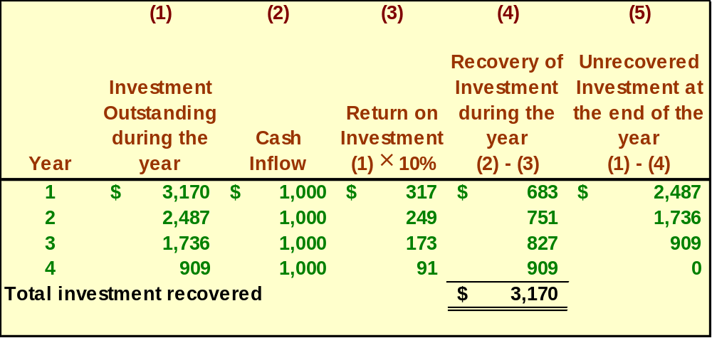
Recovery of the Original Investment
This implies that the cash inflows are sufficient to recover the $3,170 initial investment (therefore depreciation is unnecessary) and to provide exactly a 10% return on the investment.
Notes:
This implies that the cash inflows are sufficient to recover the $3,170 initial investment (therefore depreciation is unnecessary) and to provide exactly a 10 percent return on the investment.

Slide 14

Two Simplifying Assumptions
Two simplifying assumptions are usually made in net present value analysis:
All cash flows other than the initial investment occur at the end of periods.
All cash flows generated by an investment project are immediately reinvested at a rate of return equal to the discount rate.
Notes:
Two simplifying assumptions are usually made in net present value analysis:
The first assumption is that all cash flows other than the initial investment occur at the end of periods.
The second assumption is that all cash flows generated by an investment project are immediately reinvested at a rate of return equal to the discount rate.

Slide 15
Choosing a Discount Rate
The firm’s cost of capital is usually regarded as the minimum required rate of return.
The cost of capital is the average rate of return the company must pay to its long-term creditors and stockholders for the use of their funds.
Notes:
A company’s cost of capital, which is defined as the average rate of return a company must pay to its long-term creditors and shareholders for the use of their funds, is usually regarded as the minimum required rate of return. When the cost of capital is used as the discount rate, it serves as a screening device in net present value analysis.

Slide 16
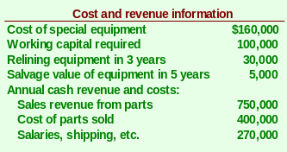
The Net Present Value Method
Lester Company has been offered a five year contract to provide component parts for a large manufacturer.
Notes:
Assume the information as shown with respect to Lester Company.

Slide 17

The Net Present Value Method
At the end of five years the working capital will be released and may be used elsewhere by Lester.
Lester Company uses a discount rate of 10%.
Should the contract be accepted?
Notes:
Also assume that at the end of five years the working capital will be released and may be used elsewhere.
Lester Company’s discount rate is 10 percent.
Should the contract be accepted?

Slide 18


The Net Present Value Method
Annual net cash inflow from operations
Notes:
The annual net cash inflow from operations of $80,000 is computed as shown.

Slide 19
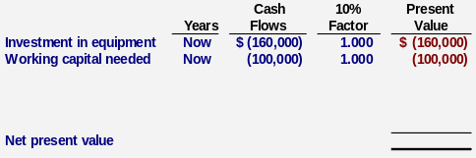
The Net Present Value Method
Notes:
Since the investments in equipment and working capital occur immediately, the discounting factor used is 1.000.

Slide 20
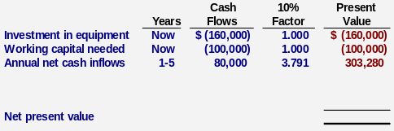
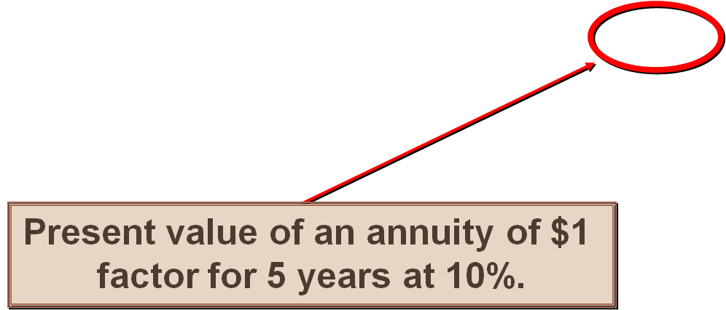
The Net Present Value Method
Notes:
The present value factor for an annuity of $1 for five years at 10 percent is 3.791. Therefore, the present value of the annual net cash inflows is $303,280.

Slide 21
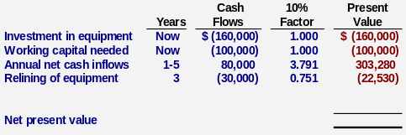
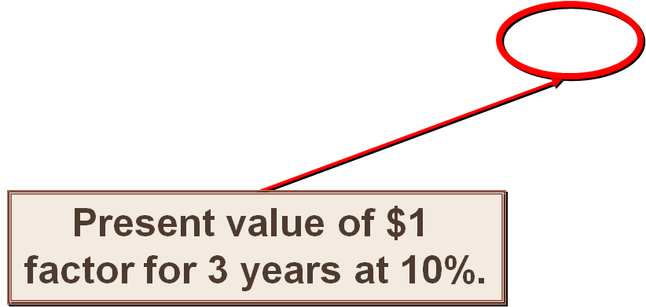
The Net Present Value Method
Notes:
The present value factor of $1 for three years at 10 percent is 0.751. Therefore, the present value of the cost of relining the equipment in three years is $22,530.

Slide 22
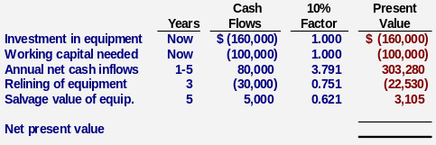
The Net Present Value Method
Present value of $1
factor for 5 years at 10%.
Notes:
The present value factor of $1 for five years at 10 percent is 0.621. Therefore, the present value of the salvage value of the equipment is $3,105.

Slide 23
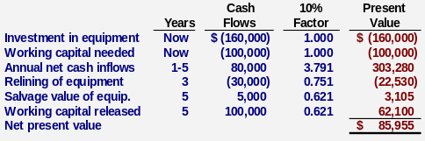
The Net Present Value Method
Accept the contract because the project has a positive net present value.
Notes:
The net present value of the investment opportunity is $85,955. Since the net present value is positive, it suggests making the investment.

Slide 24
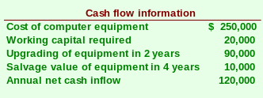

Quick Check ✓
Denny Associates has been offered a four-year contract to supply the computing requirements for a local bank.
The working capital would be released at the end of the contract.
Denny Associates requires a 14% return.
Notes:
Assume the information provided for Denny Associates.

Slide 25
P/V Factor
P/V Factor @ 10% P/V Factor @ 14%
I Year .909 . 877
II Year .826 . 769
III Year .751 . 675
Iv Year .683 . 592
vYear .621 . 519
Notes:
12 percent. Take a minute and review the solution to the problem. $79,310 divided by $22,000 equals 3.605 which is the present value factor for an annuity over five years when the interest rate is 12 percent.

Slide 26
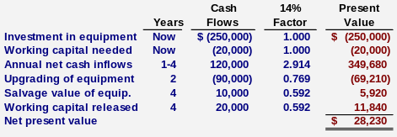
Quick Check ✓
What is the net present value of the contract with the local bank?
  a. $150,000
  b. $ 28,230
  c. $ 92,340
  d. $132,916
Notes:
$28,230. Take a minute and review the solution presented.

Slide 27
Learning Objective 2
Evaluate the acceptability of an investment project using the internal rate of return method.
Notes:
Learning objective number 2 is to evaluate the acceptability of an investment project using the internal rate of return method.

Slide 28
Internal Rate of Return Method
The internal rate of return is the rate of return that equates present value of cash inflow with the present value of cash outflow.
It works very well if a project’s cash flows are identical every year. If the annual cash flows are not identical, a trial and error process must be used to find the internal rate of return.
Notes:
The internal rate of return is the rate promised by an investment project over its useful life. It is sometimes referred to as the yield on a project.
The internal rate of return is the discount rate that will result in a net present value of zero.
The internal rate of return works very well if a project’s cash flows are identical every year. If the cash flows are not identical every year, a trial-and-error process can be used to find the internal rate of return.

Slide 29
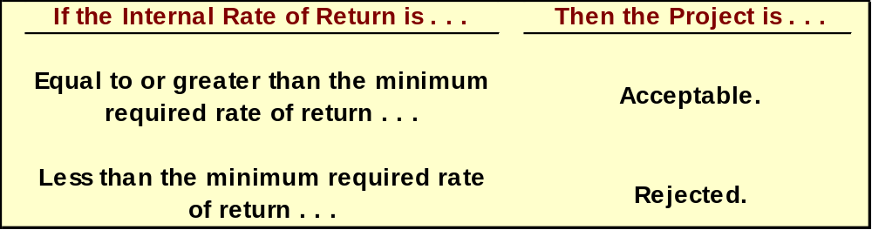
Internal Rate of Return Method
General decision rule . . .
When using the internal rate of return, the cost of capital acts as a hurdle rate that a project must clear for acceptance.
Notes:
If the internal rate of return is equal to or greater than the minimum required rate of return, then the project is acceptable. If it is less than the required rate of return, then the project is rejected.
When using internal rate of return, the cost of capital acts as a hurdle rate that a project must clear for acceptance.

Slide 30
Internal Rate of Return Method
Decker Company can purchase a new machine at a cost of Rs.60,000 that will give the following CFAT for FOUR years.
I Year Rs. 15,000
II Year Rs. 20,000
III Year Rs. 30,000
Iv Year Rs. 20,000
Calculate : NPV; PI; IRR and Pay-back period.
P/V Factor @ 10% P/V Factor @ 15%
I Year .909 . 869
II Year .826 . 756
III Year .751 . 657
Iv Year .683 . 571
Notes:
Assume the facts as shown with respect to the Decker Company.

Slide 31
Internal Rate of Return Method
The FORMULA is:
Lr + (Outflow-Inflow Lr )x Difference in Rates
Inflow Lr- Inflow Hr
Lr- Lower Rate
Hr- Higher Rate
Notes:
Using the present value of an annuity of $1 table, the internal rate of return is equal to 14 percent.

Slide 32
INTERNAL RATE OF RETURN
CFAT | P/V @ 10% | DCF AT 10% | P/V @ 15% | DCF@15%
15,0000 | .909 | 13,635 | .869 | 13,035
20,000 | .826 | 16,520 | .756 | 15,120
30,000 | .751 | 22,530 | .657 | 19,710
20,000 | .683 | 13,660 | .571 | 11,420
 |  | 66,345 |  | 59,582
 |  | 60,000
Net Present Value (NPV) |  | 6,345
Profitability Index (PI) |  | DCF OUTFLOW
 |  | 66,345 60,000
 |  | 1.1O5
Notes:
The net present value method offers two important advantages over the internal rate of return method.
The net present value method is often simpler to use.
The internal rate of return method makes a questionable assumption – that cash inflows can be reinvested at the internal rate of return.

Slide 33
INTERNAL RATE OF RETURN
Lr + (Outflow-Inflow Lr )x Difference in Rates
Inflow Lr- Inflow Hr
10+ (6345) X 5
7060
= (.898)X5= 4.49
= 10+ 4.49= 14.49
Notes:
The net present value method offers two important advantages over the internal rate of return method.
The net present value method is often simpler to use.
The internal rate of return method makes a questionable assumption – that cash inflows can be reinvested at the internal rate of return.

Slide 34
Quick Check ✓
The expected annual net cash inflow from a project is Rs.22,000 over the next 5 years. The required investment now in the project is Rs.79,310. What is the internal rate of return on the project?
  a. 10%
  b. 12%
  c. 14%
  d. Cannot be determined
Notes:
Assume the facts given for this project. What is the internal rate of return on the project?

Slide 35
P/V Factor
P/V Factor @ 10% P/V Factor @ 14%
I Year .909 . 877
II Year .826 . 769
III Year .751 . 675
Iv Year .683 . 592
vYear .621 . 519
Notes:
12 percent. Take a minute and review the solution to the problem. $79,310 divided by $22,000 equals 3.605 which is the present value factor for an annuity over five years when the interest rate is 12 percent.

Slide 36

Least Cost Decisions
In decisions where revenues are not directly involved, managers should choose the alternative that has the least total cost from a present value perspective.
Let’s look at the Home Furniture Company.
Notes:
In decisions where revenues are not directly involved, managers should choose the alternative that has the least total cost from a present value perspective.

Slide 37

Least Cost Decisions
Home Furniture Company is trying to decide whether to overhaul an old delivery truck now or purchase a new one.
The company uses a discount rate of 10%.
Notes:
Assume the following facts:
Home Furniture Company is trying to decide whether to overhaul an old delivery truck or purchase a new one.
The company uses a discount rate of 10 percent.

Slide 38
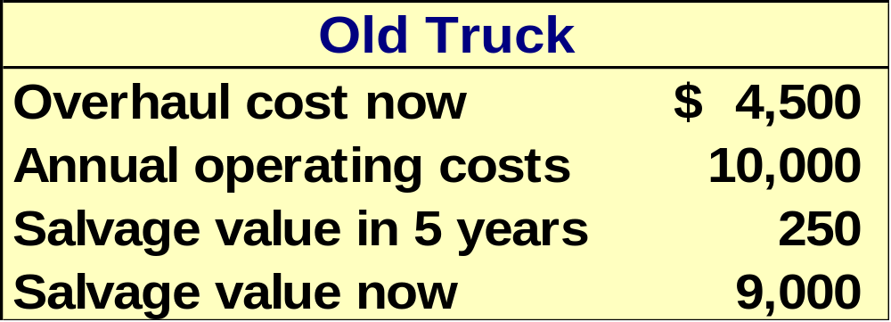

Least Cost Decisions
Here is information about the trucks . . .
Notes:
The information pertaining to the old and new trucks is as shown.

Slide 39
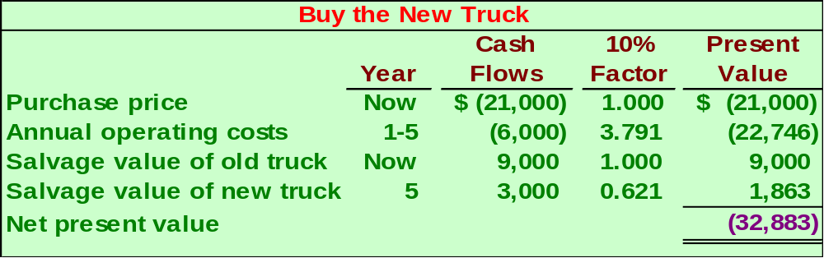
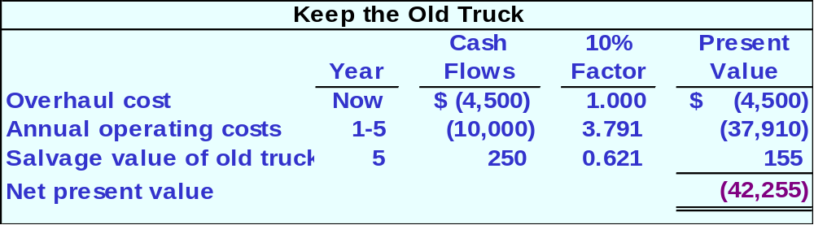

Least Cost Decisions
Notes:
The net present value of buying a new truck is ($32,883).
The net present value of overhauling the old truck is ($42,255).
Notice that both NPV numbers are negative because there is no revenue involved – this is a least cost decision.

Slide 40
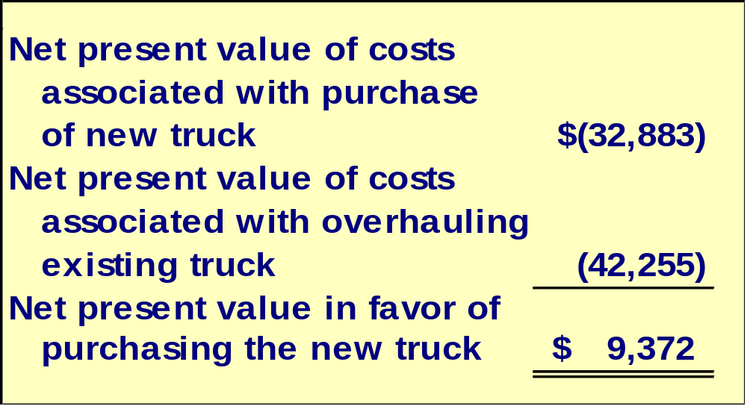
Least Cost Decisions
Home Furniture should purchase the new truck.
Notes:
The net present value in favor of purchasing the new truck is $9,372.

Slide 41
Learning Objective 4
Rank investment projects in order of preference.
Notes:
Learning objective number 4 is to rank investment projects in order of preference.

Slide 42

Preference Decision – The Ranking of Investment Projects
Screening Decisions
Preference Decisions
Pertain to whether or not some proposed investment is acceptable; these decisions come first.
Attempt to rank acceptable alternatives from the most to least appealing.
Notes:
Recall that when considering investment opportunities, managers must make two types of decisions – screening decisions and preference decisions.
Screening decisions, which come first, pertain to whether or not some proposed investment is acceptable.
Preference decisions, which come after screening decisions, attempt to rank acceptable alternatives from the most to least appealing.
Preference decisions need to be made because the number of acceptable investment alternatives usually exceeds the amount of available funds.

Slide 43
Internal Rate of Return Method
When using the internal rate of return method to rank competing investment projects, the preference rule is:
The higher the internal rate of return, the more desirable the project.
Notes:
When using the internal rate of return method to rank competing investment projects, the preference rule is: the higher the internal rate of return, the more desirable the project.

Slide 44
Capital Budgeting
Capital Budgeting
“
“A long-term planning for making and financing proposed capital outlays”
“Capital Budgeting consists in planning and development of available capital for the purpose of maximizing the long-term profitability of an organization”

Slide 45
P/V Factor
P/V Factor @ 10% P/V Factor @ 14%
I Year .909 . 877
II Year .826 . 769
III Year .751 . 675
Iv Year .683 . 592
vYear .621 . 519
Notes:
12 percent. Take a minute and review the solution to the problem. $79,310 divided by $22,000 equals 3.605 which is the present value factor for an annuity over five years when the interest rate is 12 percent.

Slide 46
Least Cost Decisions
In decisions where revenues are not directly involved, managers should choose the alternative that has the least total cost from a present value perspective.
Let’s look at the Home Furniture Company.
Notes:
In decisions where revenues are not directly involved, managers should choose the alternative that has the least total cost from a present value perspective.

Slide 47
Least Cost Decisions
Home Furniture Company is trying to decide whether to overhaul an old delivery truck now or purchase a new one.
The company uses a discount rate of 10%.
Notes:
Assume the following facts:
Home Furniture Company is trying to decide whether to overhaul an old delivery truck or purchase a new one.
The company uses a discount rate of 10 percent.

Slide 48
Least Cost Decisions
Here is information about the trucks . . .
Notes:
The information pertaining to the old and new trucks is as shown.

Slide 49
Least Cost Decisions
Notes:
The net present value of buying a new truck is ($32,883).
The net present value of overhauling the old truck is ($42,255).
Notice that both NPV numbers are negative because there is no revenue involved – this is a least cost decision.

Slide 50
Least Cost Decisions
Home Furniture should purchase the new truck.
Notes:
The net present value in favor of purchasing the new truck is $9,372.

Slide 51
Internal Rate of Return Method
When using the internal rate of return method to rank competing investment projects, the preference rule is:
The higher the internal rate of return, the more desirable the project.
Notes:
When using the internal rate of return method to rank competing investment projects, the preference rule is: the higher the internal rate of return, the more desirable the project.

Slide 52

Net Present Value Method
The net present value of one project cannot be directly compared to the net present value of another project unless the investments are equal.
Notes:
The net present value of one project cannot be directly compared to the net present value of another project, unless the investments are equal.

Slide 53
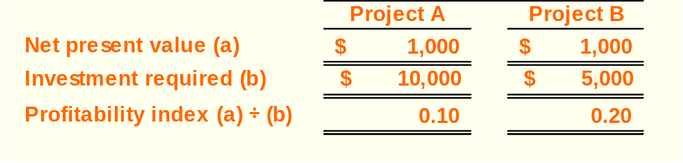
Ranking Investment Projects
Project Net present value of the project
profitability Investment required
index
=
The higher the profitability index, the
more desirable the project.
Notes:
In the case of unequal investments, a profitability index can be computed as the net present value of the project divided by the investment required. Notice three things:
The profitability indexes for investments A and B are 0.10 and 0.20, respectively.
The higher the profitability index, the more desirable the project. Therefore, investment B is more desirable than investment A.
As in this type of situation, the constrained resource is the limited funds available for investment, the profitability index is similar to the contribution margin per unit of the constrained resource as discussed an earlier chapter.

Slide 54

Other Approaches to
Capital Budgeting Decisions
Other methods of making capital budgeting decisions include:
  The Payback Method.
  Simple Rate of Return.
Notes:
This section focuses on two other methods of making capital budgeting decisions – the payback method and the simple rate of return. The payback method will be discussed first followed by the simple rate of return method.

Slide 55
Learning Objective 5
Determine the payback period for an investment.
Notes:
Learning objective number 5 is to determine the payback period for an investment.

Slide 56
The Payback Method
The payback period is the length of time that it takes for a project to recover its initial cost out of the cash receipts that it generates.
When the annual net cash inflow is the same each year, this formula can be used to compute the payback period:
Investment required
Annual net cash inflow
Payback period =
Notes:
The payback method focuses on the payback period, which is the length of time that it takes for a project to recoup its initial cost out of the cash receipts that it generates.
When the annual net cash inflow is the same every year, the formula for computing the payback period is the investment required divided by the annual net cash inflow.

Slide 57
Net Present Value Method
The net present value of one project cannot be directly compared to the net present value of another project unless the investments are equal.
Notes:
The net present value of one project cannot be directly compared to the net present value of another project, unless the investments are equal.

Slide 58
Ranking Investment Projects
Project Net present value of the project
profitability Investment required
index
=
The higher the profitability index, the
more desirable the project.
Notes:
In the case of unequal investments, a profitability index can be computed as the net present value of the project divided by the investment required. Notice three things:
The profitability indexes for investments A and B are 0.10 and 0.20, respectively.
The higher the profitability index, the more desirable the project. Therefore, investment B is more desirable than investment A.
As in this type of situation, the constrained resource is the limited funds available for investment, the profitability index is similar to the contribution margin per unit of the constrained resource as discussed an earlier chapter.

Slide 59
Other Approaches to
Capital Budgeting Decisions
Other methods of making capital budgeting decisions include:
  The Payback Method.
  Simple Rate of Return.
Notes:
This section focuses on two other methods of making capital budgeting decisions – the payback method and the simple rate of return. The payback method will be discussed first followed by the simple rate of return method.

Slide 60
Learning Objective 5
Determine the payback period for an investment.
Notes:
Learning objective number 5 is to determine the payback period for an investment.

Slide 61
The Payback Method
The payback period is the length of time that it takes for a project to recover its initial cost out of the cash receipts that it generates.
When the annual net cash inflow is the same each year, this formula can be used to compute the payback period:
Investment required
Annual net cash inflow
Payback period =
Notes:
The payback method focuses on the payback period, which is the length of time that it takes for a project to recoup its initial cost out of the cash receipts that it generates.
When the annual net cash inflow is the same every year, the formula for computing the payback period is the investment required divided by the annual net cash inflow.

Slide 62
The Payback Method
Management at The Daily Grind wants to install an espresso bar in its restaurant that
  Costs $140,000 and has a 10-year life.
  Will generate annual net cash inflows of $35,000.
Management requires a payback period of 5 years or less on all investments.
What is the payback period for the espresso bar?
Notes:
Assume the management of the Daily Grind wants to install an espresso bar in its restaurant.
The cost of the espresso bar is $140,000 at it has a ten-year life.
The bar will generate annual net cash inflows of $35,000.
Management requires a payback period of five years or less.
What is the payback period on the espresso bar?

Slide 63
The Payback Method
Investment required
Annual net cash inflow
Payback period =
$140,000
$35,000
Payback period =
Payback period =
4.0 years
According to the company’s criterion, management would invest in the espresso bar because its payback period is less than 5 years.
Notes:
The payback period is 4 years. Therefore, management would choose to invest in the bar.

Slide 64


Evaluation of the Payback Method
Ignores the
time value
of money.
Short-comings
of the payback
period.
Ignores cash
flows after
the payback
period.
Notes:
Criticisms of the payback method include the following.
First, a shorter payback period does not always mean that one investment is more desirable than another. This is because the payback method ignores cash flows after the payback period, thus it has no inherent mechanism for highlighting differences in useful life between investments.
Second, the payback method does not consider the time value of money.

Slide 65
Evaluation of the Payback Method
Serves as screening tool.
Identifies investments that recoup cash investments quickly.
Strengths
of the payback
period.
Identifies products that recoup initial investment quickly.
Notes:
Strengths of the payback method include the following.
It can serve as a screening tool to help identify which investment proposals are in the “ballpark.”
It can aid companies that are “cash poor” in identifying investments that will recoup cash investments quickly.
It can help companies that compete in industries where products become obsolete rapidly to identify products that will recoup their initial investment quickly.

Slide 66

Payback and Uneven Cash Flows
When the cash flows associated with an investment project change from year to year, the payback formula introduced earlier cannot be used.
Instead, the un-recovered investment must be tracked year by year.
$1,000
$0
$2,000
$1,000
$500
1
2
3
4
5
Notes:
When the cash flows associated with an investment project change from year to year, the payback formula introduced earlier cannot be used. Instead, the un-recovered investment must be tracked year by year.

Slide 67
Payback and Uneven Cash Flows
For example, if a project requires an initial investment of $4,000 and provides uneven net cash inflows in years 1-5 as shown, the investment would be fully recovered in year 4.
$1,000
$0
$2,000
$1,000
$500
1
2
3
4
5
Notes:
For example, if a project requires an initial investment of $4,000 and provides uneven net cash inflows in years one to five as shown, the investment would be fully recovered in year four.

Slide 68
Learning Objective 6
Compute the simple rate of return for an investment.
Notes:
Learning objective number 6 is to compute the simple rate of return for an investment.

Slide 69
Simple Rate of Return Method
Does not focus on cash flows -- rather it focuses on accounting net operating income.
The following formula is used to calculate the simple rate of return:
-
Annual incremental net operating income
Simple rate
of return
=
Initial investment*
*Should be reduced by any salvage from the sale of the old equipment
Notes:
The simple rate of return method (also known as the accounting rate of return or the unadjusted rate of return) does not focus on cash flows, rather it focuses on accounting net operating income.
The equation for computing the simple rate of return is as shown.

Slide 70

Simple Rate of Return Method
Management of The Daily Grind wants to install an espresso bar in its restaurant that:
  Cost $140,000 and has a 10-year life.
  Will generate incremental revenues of $100,000 and incremental expenses of $65,000 including depreciation.
What is the simple rate of return on the investment project?
Notes:
Assume the management of the Daily Grind wants to install an espresso bar in its restaurant.
The cost of the espresso bar is $140,000 and it has a ten-year life.
The espresso bar will generate incremental revenues of $100,000 and incremental expenses of $65,000 including depreciation.
What is the simple rate of return on this project?

Slide 71
Simple Rate of Return Method
Simple rate
of return
$35,000
$140,000
=
= 25%
Notes:
The simple rate of return is 25 percent.

Slide 72
Criticism of the Simple Rate of Return
Ignores the
time value
of money.
Short-comings
of the simple
rate of return.
The same project
may appear
desirable in some
years and
undesirable
in other years.
Notes:
Criticisms of the simple rate of return include the following:
First, it does not consider the time value of money.
Second, the simple rate of return fluctuates from year to year when used to evaluate projects that do not have constant annual incremental revenues and expenses. The same project may appear desirable in some years and undesirable in others.

Slide 73

Postaudit of Investment Projects
A postaudit is a follow-up after the project has been completed to see whether or not expected results were actually realized.
Notes:
A postaudit is a follow-up after the project has been completed to see whether or not expected results were actually realized.
The data used in a postaudit analysis should be actual observed data rather than estimated data.

Slide 74
The Concept of Present Value
Appendix 13A
Notes:
Appendix 13A: The Concept of Present Value.

Slide 75
Learning Objective 7
(Appendix 13A)
Understand present value concepts and the use of present value tables.
Notes:
Learning objective number 7 is to understand present value concepts and the use of present value tables.

Slide 76

The Mathematics of Interest
A dollar received today is worth more than a dollar received a year from now because you can put it in the bank today and have more than a dollar a year from now.
Notes:
A dollar received today is worth more than a dollar received a year from now because you can put it in the bank today and have more than a dollar a year from now.

Slide 77
The Mathematics of Interest – An Example
Assume a bank pays 8% interest on a $100 deposit made today. How much will the $100 be worth in one year?
F_{n} = P(1 + r)^{n}
F = the balance at the end of the period n.
P = the amount invested now.
r = the rate of interest per period.
n = the number of periods.
Notes:
Assume a bank pays 8 percent interest on a $100 deposit made today. How much will the $100 be worth in one year? The equation needed to answer this question is as shown, where:
F is the balance at the end of the period.
P is the amount invested now.
r is the rate of interest per period.
n is the number of periods.

Slide 78
The Mathematics of Interest – An Example
Assume a bank pays 8% interest on a $100 deposit made today. How much will the $100 be worth in one year?
F_{n} = P(1 + r)^{n}
F₁ = $100(1 + .08)¹
F₁ = $108.00
Notes:
Solving this equation, the answer is $108. The $100 outlay is called the present value of the $108 amount to be received in one year. It is also known as the discounted value of the future $108 receipt.

Slide 79
Compound Interest – An Example
What if the $108 was left in the bank for a second year? How much would the original $100 be worth at the end of the second year?
F_{n} = P(1 + r)^{n}
F = the balance at the end of the period n.
P = the amount invested now.
r = the rate of interest per period.
n = the number of periods.
Notes:
What if the $108 was left in the bank for a second year? How much would the original $100 be worth at the end of the second year? The equation needed to answer this question is as shown, where:
F is the balance at the end of the periods.
P is the amount invested now.
r is the rate of interest per period.
n is the number of periods.

Slide 80
Compound Interest – An Example
F₂ = $100(1 + .08)²
F₂ = $116.64
The interest that is paid in the second year on the interest earned in the first year is known as compound interest.
Notes:
Solving this equation, the answer is $116.64.
The interest that is paid in the second year on the interest earned in the first year is known as compound interest.

Slide 81
Computation of Present Value
An investment can be viewed in two ways—its future value or its present value.
Present Value
Future Value
Let’s look at a situation where the future value is known and the present value is the unknown.
Notes:
An investment can be viewed in two ways – its future value or its present value. In the example just completed, the present value was known and the future value was the unknown that we computed.
Let’s look at the opposite situation – the future value is known and the present value is the unknown that we must compute.

Slide 82
Present Value – An Example
If a bond will pay $100 in two years, what is the present value of the $100 if an investor can earn a return of 12% on investments?
F_{n}
P =
(1 + r)^{n}
F = the balance at the end of the period n.
P = the amount invested now.
r = the rate of interest per period.
n = the number of periods.
Notes:
Assume a bond will pay $100 in two years. If investors can earn 12 percent on their investments, what is the present value of the bond? The equation needed to answer this question is as shown, where:
F is the balance at the end of the periods.
P is the amount invested now.
r is the rate of interest per period.
n is the number of periods.

Slide 83
Present Value – An Example
$100
P =
(1 + .12)²
$79.72
P =
This process is called discounting. We have discounted the $100 to its present value of $79.72. The interest rate used to find the present value is called the discount rate.
Notes:
Solving this equation, P is $79.72.
This process is called discounting. We have discounted the $100 to its present value of $79.72. The interest rate used to find the present value is called the discount rate.

Slide 84
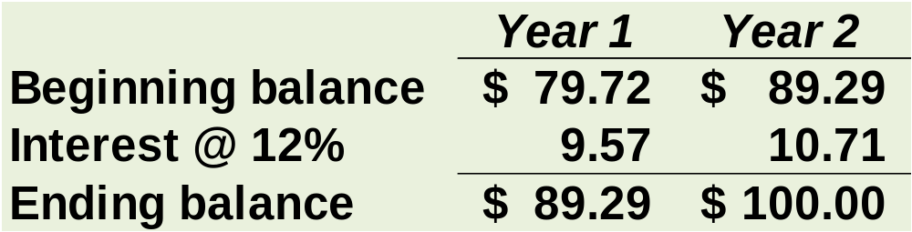
Present Value – An Example
Let’s verify that if we put $79.72 in the bank today at 12% interest that it would grow to $100 at the end of two years.
If $79.72 is put in the bank today and earns 12%, it will be worth $100 in two years.
Notes:
We can verify, as shown on the slide, that if we put $79.72 in the bank today at 12 percent interest, it would grow to $100 at the end of two years.

Slide 85
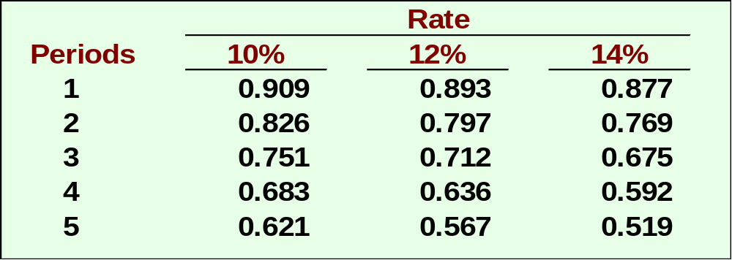
Present Value – An Example
$100 × 0.797 = $79.70 present value
Present value factor of $1 for 2 periods at 12%.
Notes:
We can also use the present value of one dollar table from Appendix B-1 to verify the accuracy of the $79.72 figure.
An excerpt of the appropriate table is as shown.
The appropriate present value factor is 0.797 and the present value is $79.72. The $0.02 difference is due to rounding.

Slide 86
Quick Check ✓
How much would you have to put in the bank today to have $100 at the end of five years if the interest rate is 10%?
  a. $62.10
  b. $56.70
  c. $90.90
  d. $51.90
Notes:
How much would you have to put in the bank today to have $100 at the end of five years if the interest rate is 10 percent?

Slide 87
Quick Check ✓
How much would you have to put in the bank today to have $100 at the end of five years if the interest rate is 10%?
  a. $62.10
  b. $56.70
  c. $90.90
  d. $51.90
$100 × 0.621 = $62.10
Notes:
$62.10. Review the solution provided.

Slide 88
Present Value of a Series of Cash Flows
An investment that involves a series of identical cash flows at the end of each year is called an annuity.
$100
$100
$100
$100
$100
$100
1
2
3
4
5
6
Notes:
Although some investments involve a single sum to be received (or paid) at a single point in the future, other investments involve a series of identical cash flows known as an annuity.

Slide 89
Present Value of a Series of Cash Flows – An Example
Lacey Inc. purchased a tract of land on which a $60,000 payment will be due each year for the next five years. What is the present value of this stream of cash payments when the discount rate is 12%?
Notes:
Assume Lacey Inc. purchased a tract of land on which a $60,000 payment will be due each of the next five years.
What is the present value of this stream of cash payments when the discount rate is 12 percent?

Slide 90
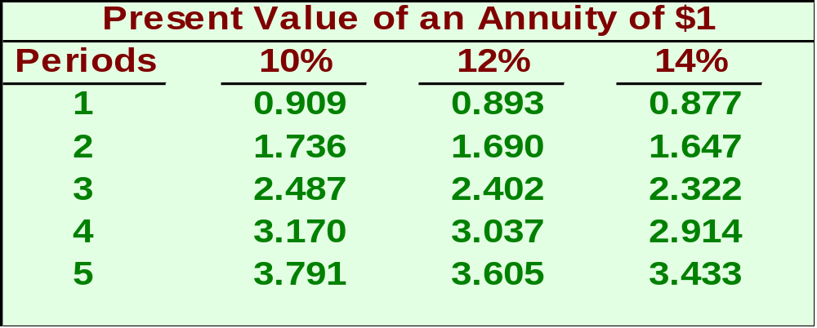
Present Value of a Series of Cash Flows – An Example
We could solve the problem like this . . .
$60,000 × 3.605 = $216,300
Notes:
Appendix 13B-2 contains a present value of an annuity of $1 table.
An excerpt from this table is as shown.
The appropriate present value factor is 3.605. The present value is $216,300.

Slide 91
Quick Check ✓
If the interest rate is 14%, how much would you have to put in the bank today so as to be able to withdraw $100 at the end of each of the next five years?
  a. $34.33
  b. $500.00
  c. $343.30
  d. $360.50
Notes:
If the interest rate is 14 percent, how much would you have to put in the bank today so as to be able to withdraw $100 at the end of each of the next five years?

Slide 92
Quick Check ✓
If the interest rate is 14%, how much would you have to put in the bank today so as to be able to withdraw $100 at the end of each of the next five years?
  a. $34.33
  b. $500.00
  c. $343.30
  d. $360.50
$100 × 3.433 = $343.30
Notes:
$343.30. Review the solution provided.

Slide 93
Income Taxes in Capital Budgeting Decisions
Appendix 13C
Notes:
Appendix 13C: Income Taxes in Capital Budgeting Decisions

Slide 94
Learning Objective 8
(Appendix 13C)
Include income taxes in a capital budgeting analysis.
Notes:
Learning objective number 8 is to include income taxes in a capital budgeting analysis.

Slide 95
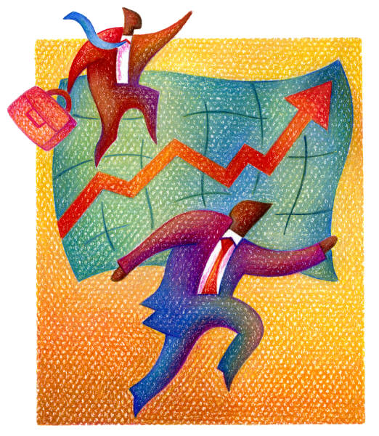
Simplifying Assumptions
Taxable income equals net income as computed for financial reports.
The tax rate is a flat percentage of taxable income.
Notes:
First, let’s identify some simplifying assumptions.
Taxable income equals net income as computed for financial reports.
The tax rate is a flat percentage of taxable income.

Slide 96
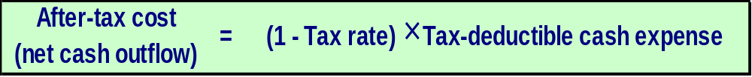
Concept of After-tax Cost
An expenditure net of its tax effect is known as after-tax cost.
Here is the equation for determining the after-tax cost of any tax-deductible cash expense:
Notes:
An expenditure net of its tax effect is known as after-tax cost.
The equation for determining the after-tax cost of any tax-deductible cash expense is as shown.

Slide 97
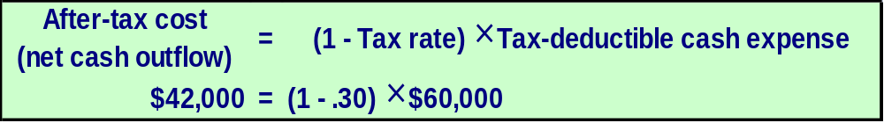
After-tax Cost – An Example
Assume a company with a 30% tax rate is contemplating investing in a training program that will cost $60,000 per year.
We can use this equation to determine that the after-tax cost of the training program is $42,000.
Notes:
Assume a company with a 30 percent tax rate is contemplating investing in a training program that will cost $60,000 per year.
The aforementioned equation can be used to determine that the after-tax cost of the training program is $42,000.

Slide 98
After-tax Cost – An Example
The answer can also be determined by calculating the taxable income and income tax for two alternatives—without the training program and with the training program.
The after-tax cost of the training program is the same—$42,000.
Notes:
The answer can also be determined by calculating the taxable income and income tax for two alternatives – without the training program and with the training program.
Notice that the after-tax cost of the training program would be the same – $42,000.

Slide 99
After-tax Cost – An Example
The amount of net cash inflow realized from a taxable cash receipt after income tax effects have been considered is known as the after-tax benefit.
Notes:
The amount of net cash inflow realized from a taxable cash receipt after income tax effects have been considered is known as the after-tax benefit.
The equation for determining the after-tax benefit of any taxable cash receipt is as shown.

Slide 100
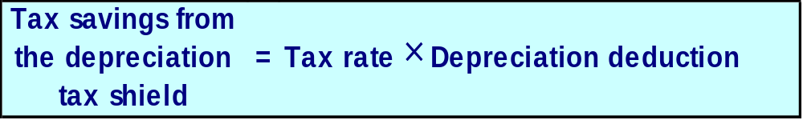
Depreciation Tax Shield
While depreciation is not a cash flow, it does affect the taxes that must be paid and therefore has an indirect effect on a company’s cash flows.
Notes:
While depreciation is not a cash flow, it does affect the taxes that must be paid and therefore has an indirect effect on a company’s cash flows.
When depreciation deductions shield revenues from taxation, they are generally referred to as a depreciation tax shield. The equation for calculating the tax savings from a depreciation tax shield is as shown.
Remember that when as asset is purchased, a cash outflow occurs. Depreciation is just the allocation of that purchase price over some estimated life.

Slide 101
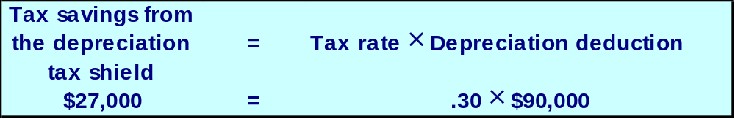
Depreciation Tax Shield – An Example
Assume a company has annual cash sales and cash operating expenses of $500,000 and $310,000, respectively; a depreciable asset, with no salvage value, on which the annual straight-line depreciation expense is $90,000; and a 30% tax rate.
Notes:
Assume that a company has: annual cash sales and cash operating expenses of $500,000 and $310,000, respectively; a depreciable asset, with no salvage value, on which the annual straight-line depreciation expense is $90,000; and a 30 percent tax rate.

Slide 102
Depreciation Tax Shield – An Example
Assume a company has annual cash sales and cash operating expenses of $500,000 and $310,000, respectively; a depreciable asset, with no salvage value, on which the annual straight-line depreciation expense is $90,000; and a 30% tax rate.
The depreciation tax shield is $27,000.
Notes:
The aforementioned equation can be used to calculate the depreciation tax shield of $27,000.

Slide 103
Depreciation Tax Shield – An Example
The answer can also be determined by calculating the taxable income and income tax for two alternatives—without the depreciation deduction and with the depreciation deduction.
The depreciation tax shield is the same—$27,000.
Notes:
The answer can also be determined by calculating the taxable income and income tax for two alternatives – without the depreciation deduction and with the depreciation deduction.
Notice that the depreciation tax shield would be the same – $27,000.

Slide 104

Holland Company – An Example
Holland Company owns the mineral rights to land that has a deposit of ore. The company is deciding whether to purchase equipment and open a mine on the property. The mine would be depleted and closed in 10 years and the equipment would be sold for its salvage value.
More information is provided on the next slide.
Notes:
Holland Company owns the mineral rights to land that has a deposit of ore. The company is deciding whether to purchase equipment and open a mine on the property. The mine would be depleted and closed in ten years and the equipment would be sold for its salvage value.

Slide 105
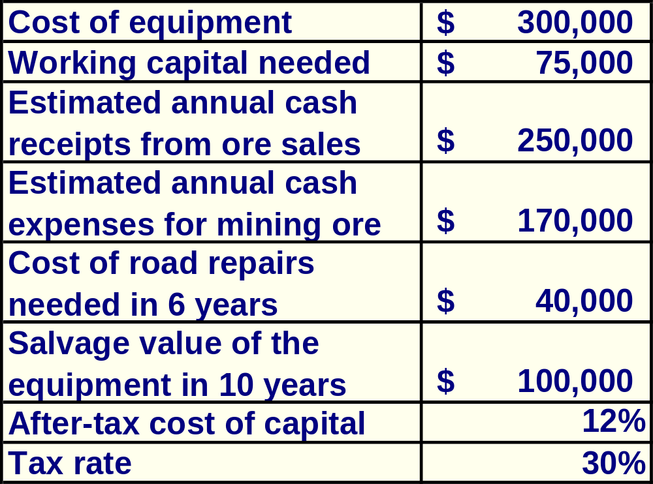
Holland Company – An Example
Should Holland open a mine on the property?
Notes:
Pertinent financial information is as shown.
Holland’s after-tax cost of capital is 12 percent and its tax rate is 30 percent.
Should Holland open a mine on the property?

Slide 106
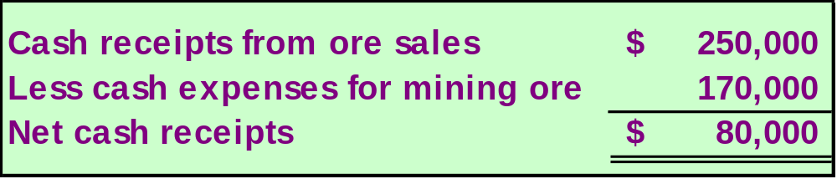
Holland Company – An Example
Step One: Compute the annual net cash receipts from operating the mine.
Notes:
The first step is to compute the annual net cash receipts of $80,000 from operating the mine.

Slide 107
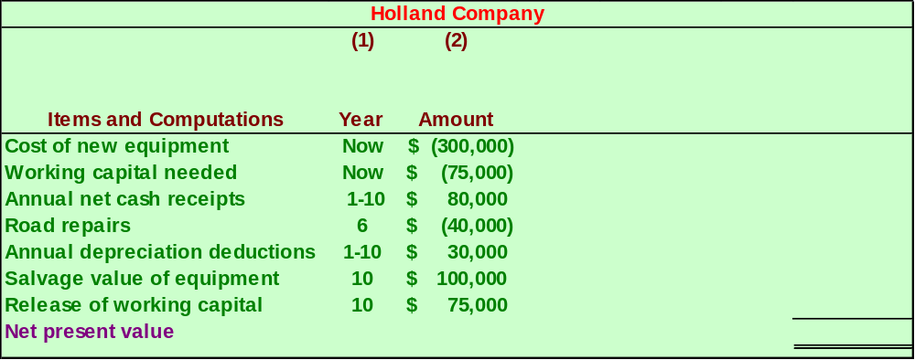
Holland Company – An Example
Step Two: Identify all relevant cash flows as shown.
Notes:
The second step is to identify all relevant cash flows as shown.
Notice, that Holland uses straight-line depreciation, assuming no salvage value, to compute depreciation deductions for tax purposes.

Slide 108
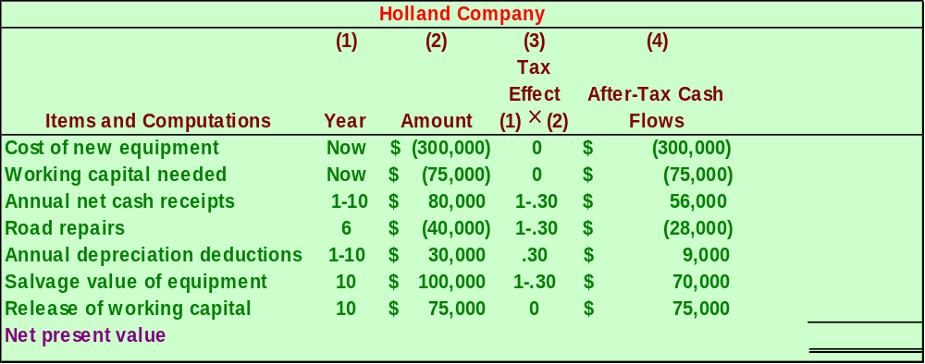
Holland Company – An Example
Step Three: Translate the relevant cash flows to after-tax cash flows as shown.
Notes:
The third step is to translate the relevant cash flows to after-tax cash flows as shown.

Slide 109
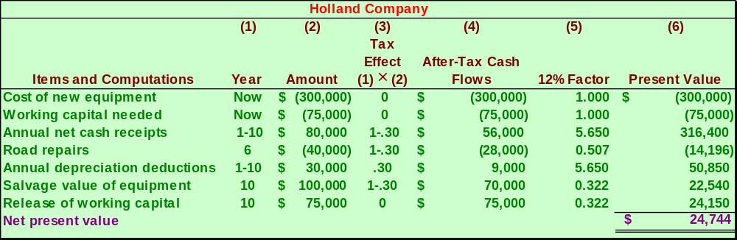
Holland Company – An Example
Step Four: Discount all cash flows to their present value as shown.
Notes:
The fourth step is to discount all cash flows to their present value as shown.
Notice that the net present value of the project is $24,744.

Slide 110

End of Chapter 13
Notes:
End of Chapter 13.

